Slide 1
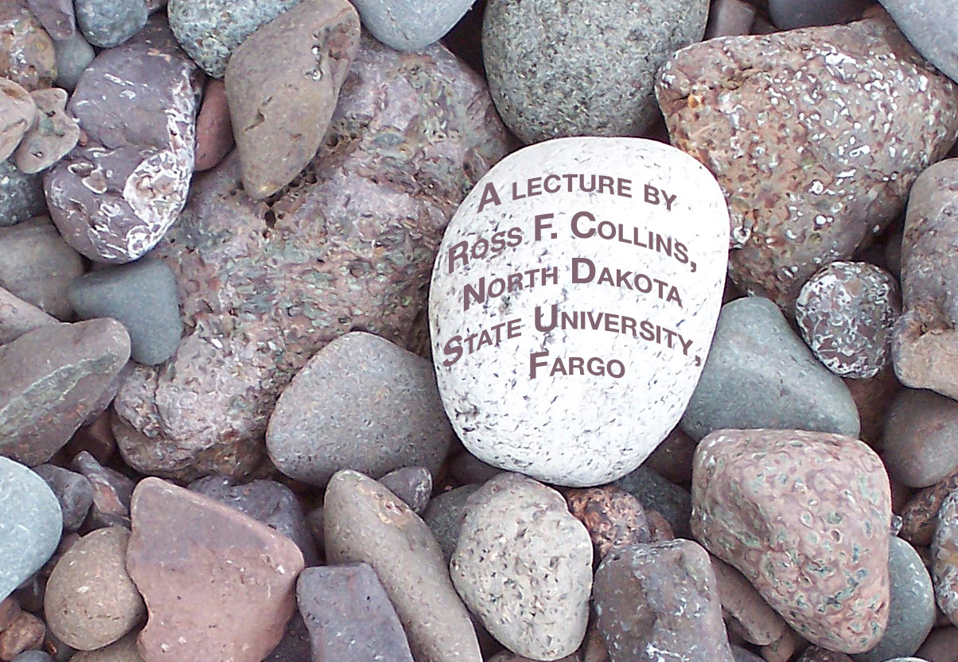
Ways of seeing
We may look. But do we see?

Slide 2
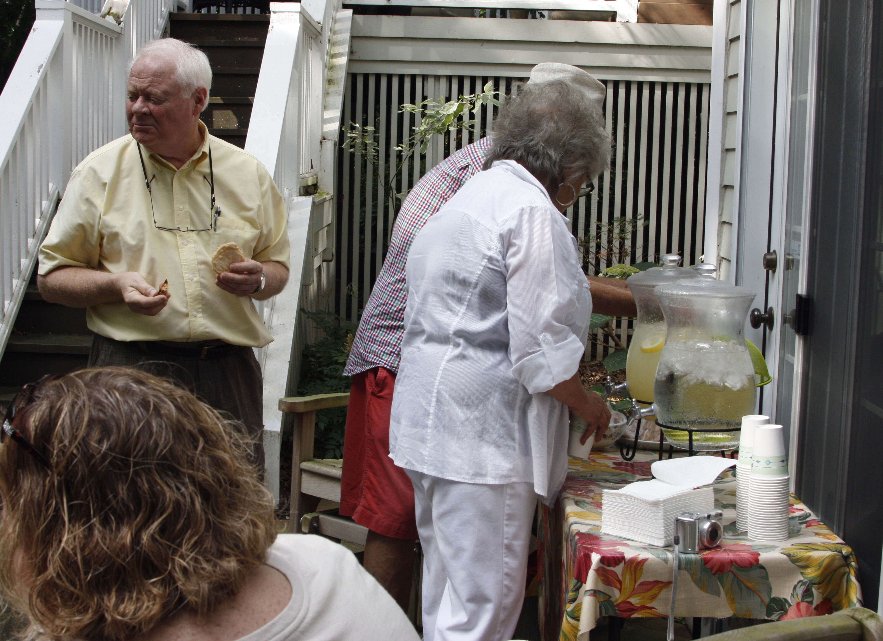
The art of seeing
Most of us have the wonderful gift of sight.
But not many of us truly look.
We move through our busy lives, taking for granted the visual world around us.

Slide 3
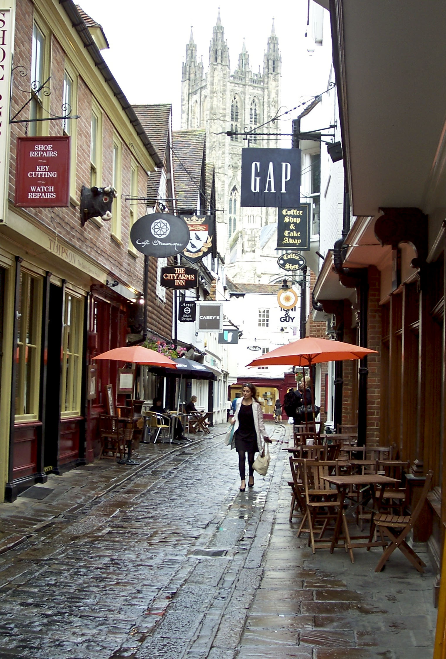
Shapes, patterns and colors
Our world is filled with shapes, patterns, colors, textures and lights. But we don’t normally notice.

Slide 4
Our make-up world of images
When we draw, paint, or take a photo, we create a world in an image.
We create an abstraction of our physical world.
When we do this, we are forced to take a closer look at the details around us.
We realize how many complex things go together to create our physical world, and how difficult that is to portray in art and photography.

Slide 5
Visual research
Gestalt research has shown people do not look at the physical world in discrete ways.
In other words, we don’t look at single objects or parts, put them together in our minds, and come up with a view, like adding a sum of numbers.
Instead, we see everything all at once, as a whole.

Slide 6
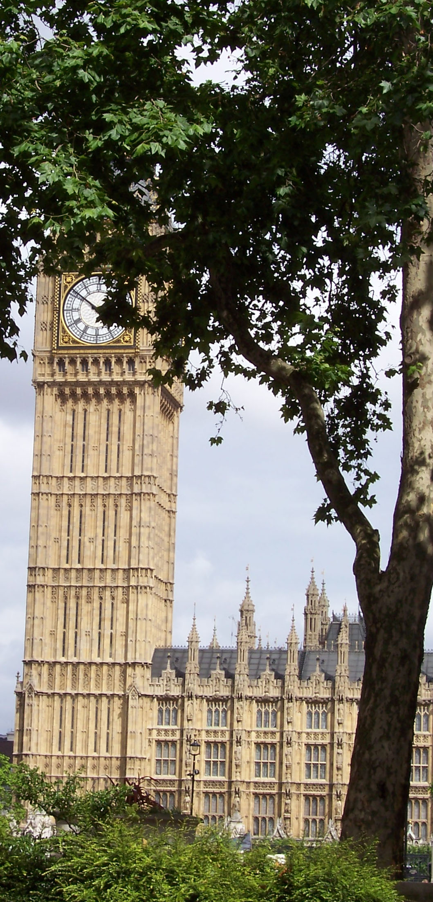
How do we see a tree?
How do we determine, for example, something as basic as a tree?
Do I look out the window to see a brown, basically cylindrical, vertical shape, with lines radiating from the top, and attached to that, green, vaguely circular shapes?
Of course not. I don’t begin by putting together the pieces. I see a tree!
So the impression of complex shapes coming together is not perceived that way.

Slide 7
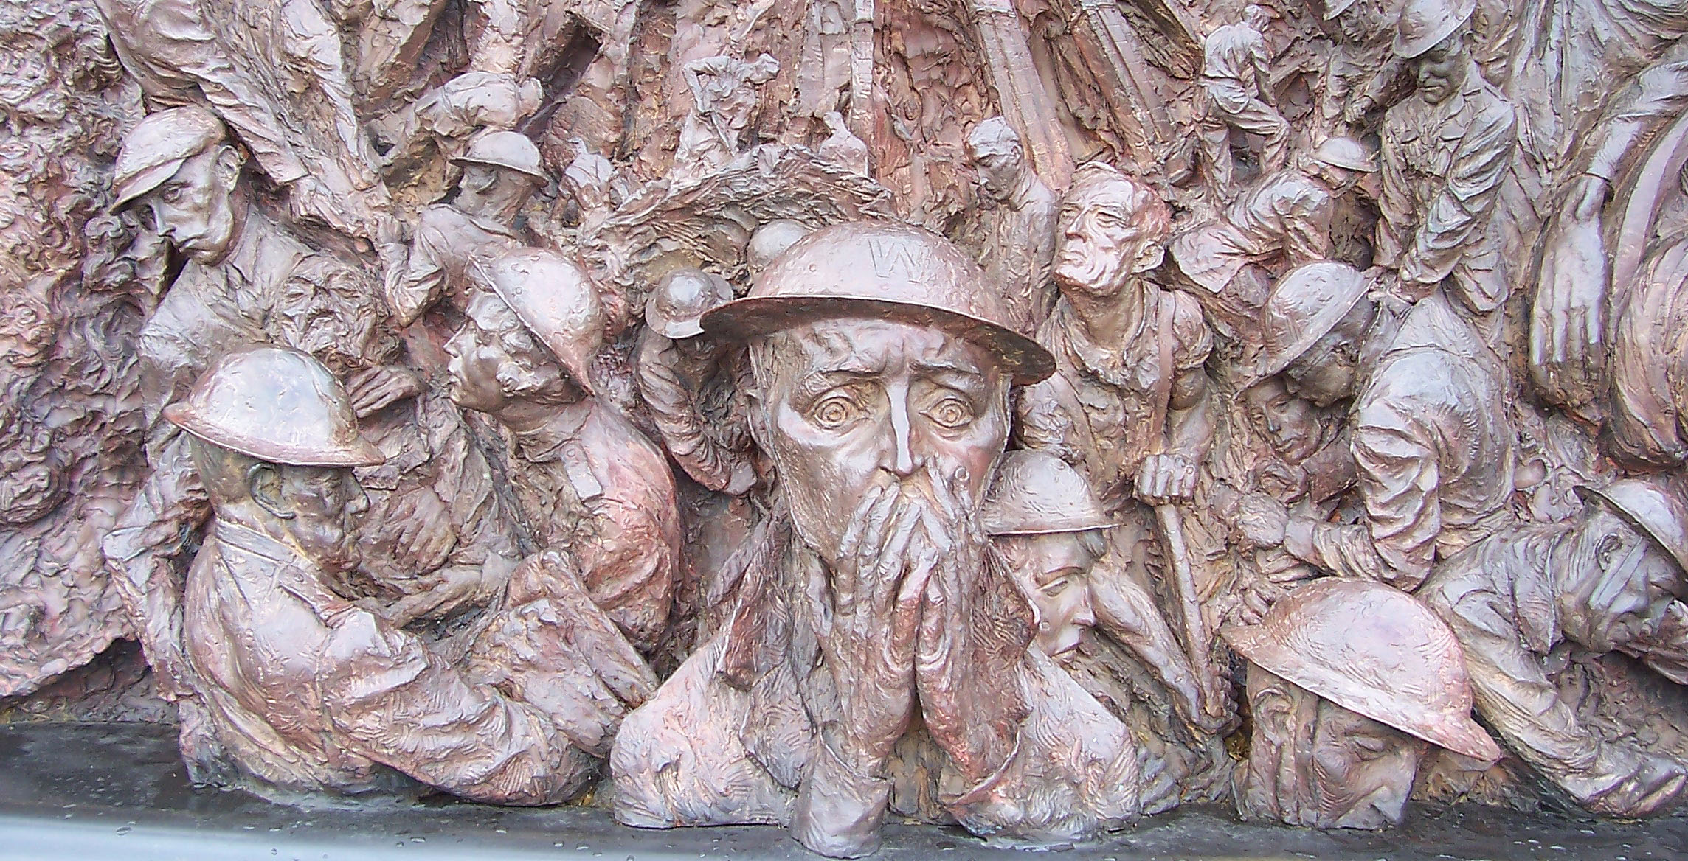
Abstraction of reality
Learning to draw or paint, however, requires us to learn all over again how to see.
We must turn complex reality into a simpler image—because it is impossible to reproduce the entire reality.
So in art you look at line, shape, texture, color—the elements of the world of art—to analyze your image in a new way.
People new to making art from life quickly realize how difficult this is.

Slide 8
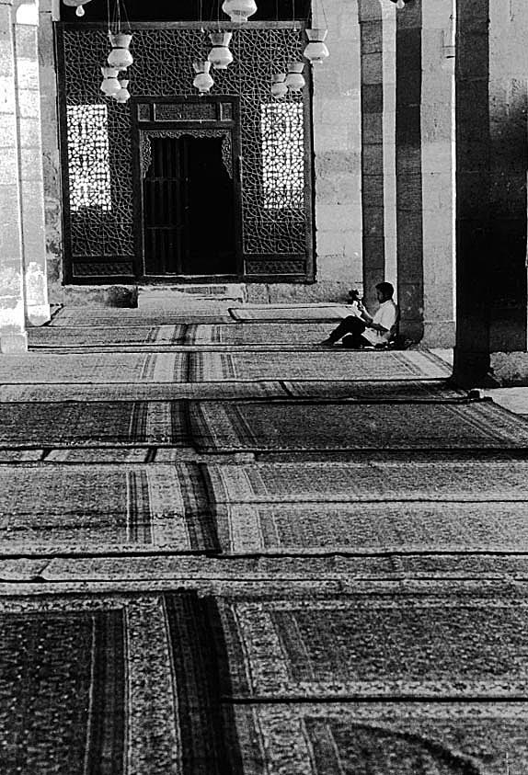
Not the real world
We realize, then, that art in any form—painting, sculpture, photography—is not reality as we see it. It is an abstraction.
That is, we take a three-dimensional event that is happening, changing, moving in time. We freeze it into a two-dimensional world, usually, and on a piece of paper or screen.
For photographers, often that frozen world also will be in black and white, and so further abstracted from reality.

Slide 9
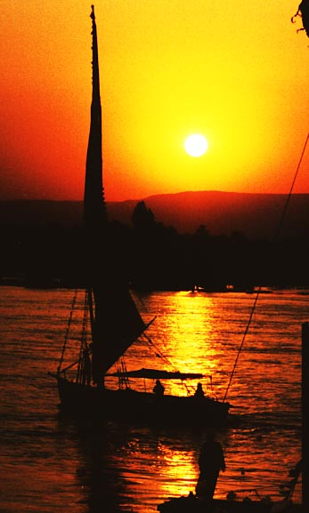
A translation
When we are at an event, or looking at a scene, how we react to that is not what ends up on paper or Web.
Instead, it’s a translation of what we saw and felt into a new environment.
This is why for many of us the photo so often disappoints. It doesn’t seem to translate what we saw or felt.
It is difficult to translate reality into a photography. And that’s the art of seeing.

Slide 10
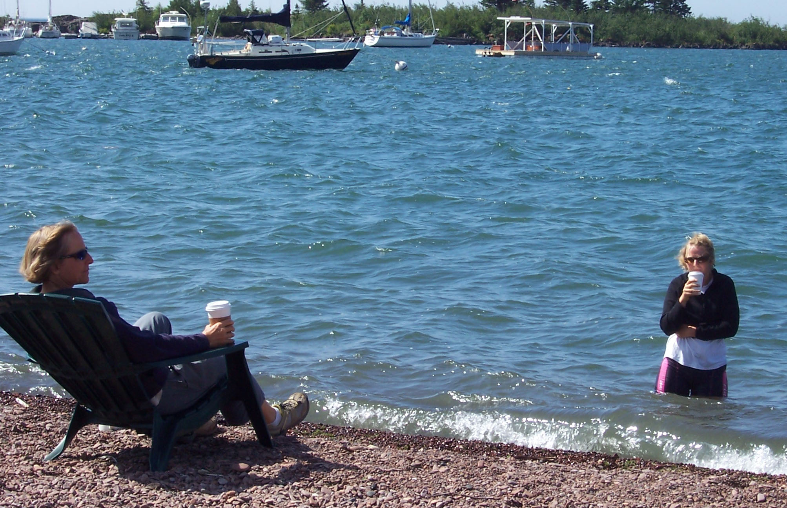
A frame
As photographers we not only have to abstract reality.
We also have to put it in a frame, one direction, with boundaries, a slice of life.
The boundaries change relationships in the scene, an instant frozen in time.

Slide 11
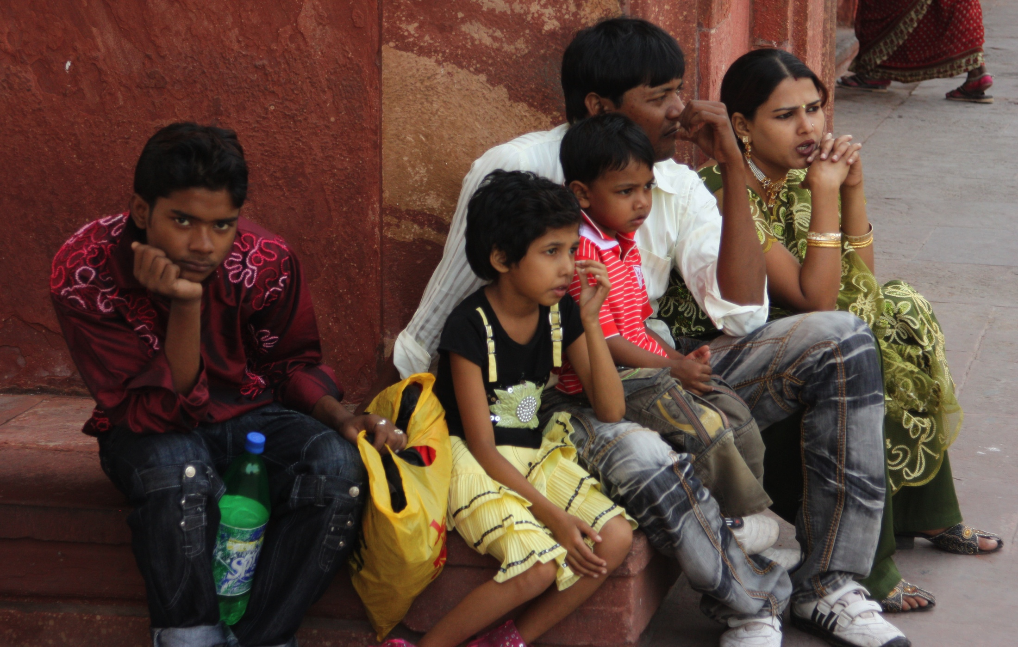
Freezing a moment
The idea of freezing a moment in time can help us sometimes, as photographers.
It can make the relationships and juxtapositions of an image seem to have more meaning than we would have felt in the fleeting moment.

Slide 12
The fleeting moment
Sometimes this works. Sometimes it doesn’t.
The key, then, to taking better photos is to look at reality in a different way from the way we saw it in the past.
That is, as photographers say, learn to see.

Slide 13
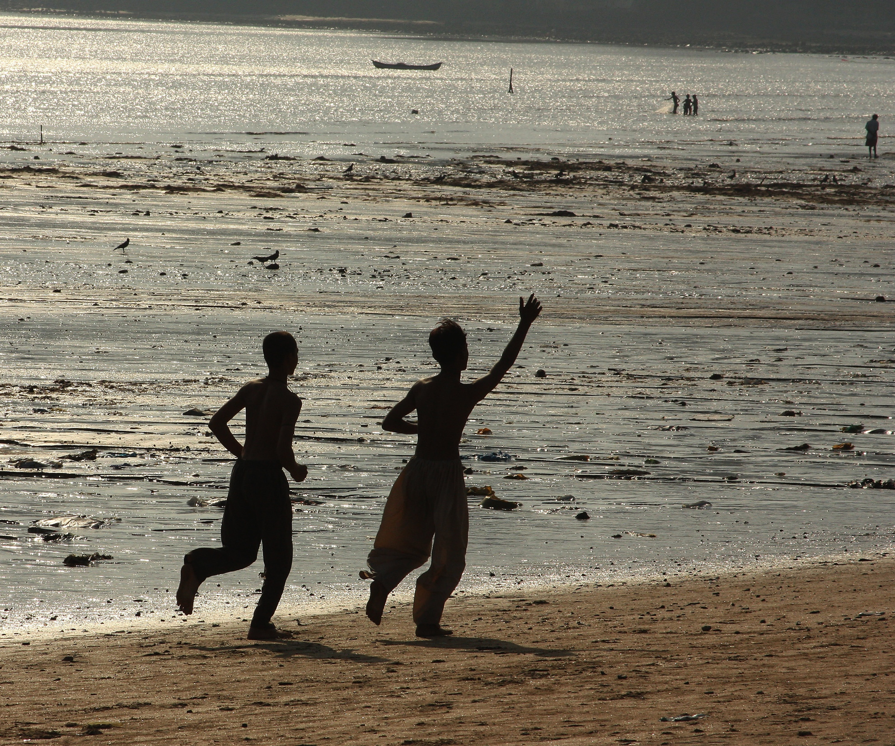
Light
We do this when we consider light.
Most people don’t notice quality or direction of light.
Photographers, however, tend to instinctively analyze light where ever they go.

Slide 14
beyond basics
Once we understand the basics of light, we can go on to consider other aspects of a scene.
How do we make choices?
To begin with, try to visualize yourself as the photographer of other images you like. Why did the photographer choose what she did? Why did he leave out what he did?

Slide 15
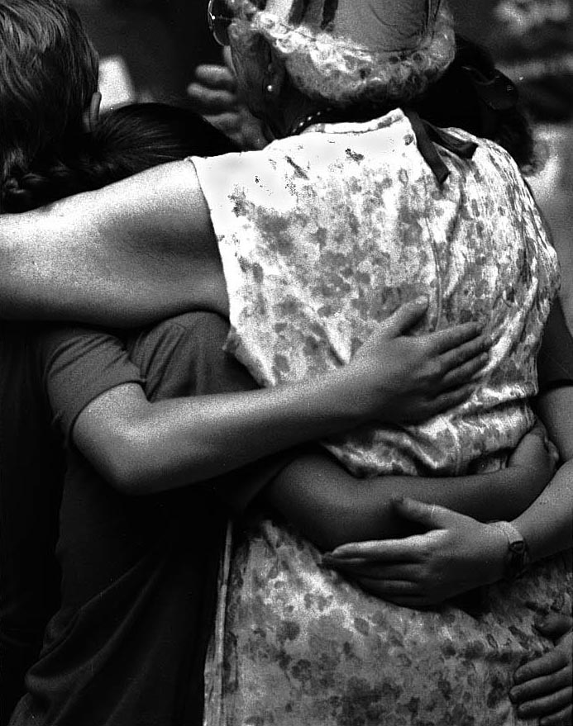
Visualize
You can also use the visualizing process for making your own images.
Visualize the scene in your viewfinder as if it were transferred to a two-dimensional surface, such as a piece of paper or screen.
Consider the image both in color and abstracted into black and white—where you have no color to distract, only line, shape and tone.

Slide 16
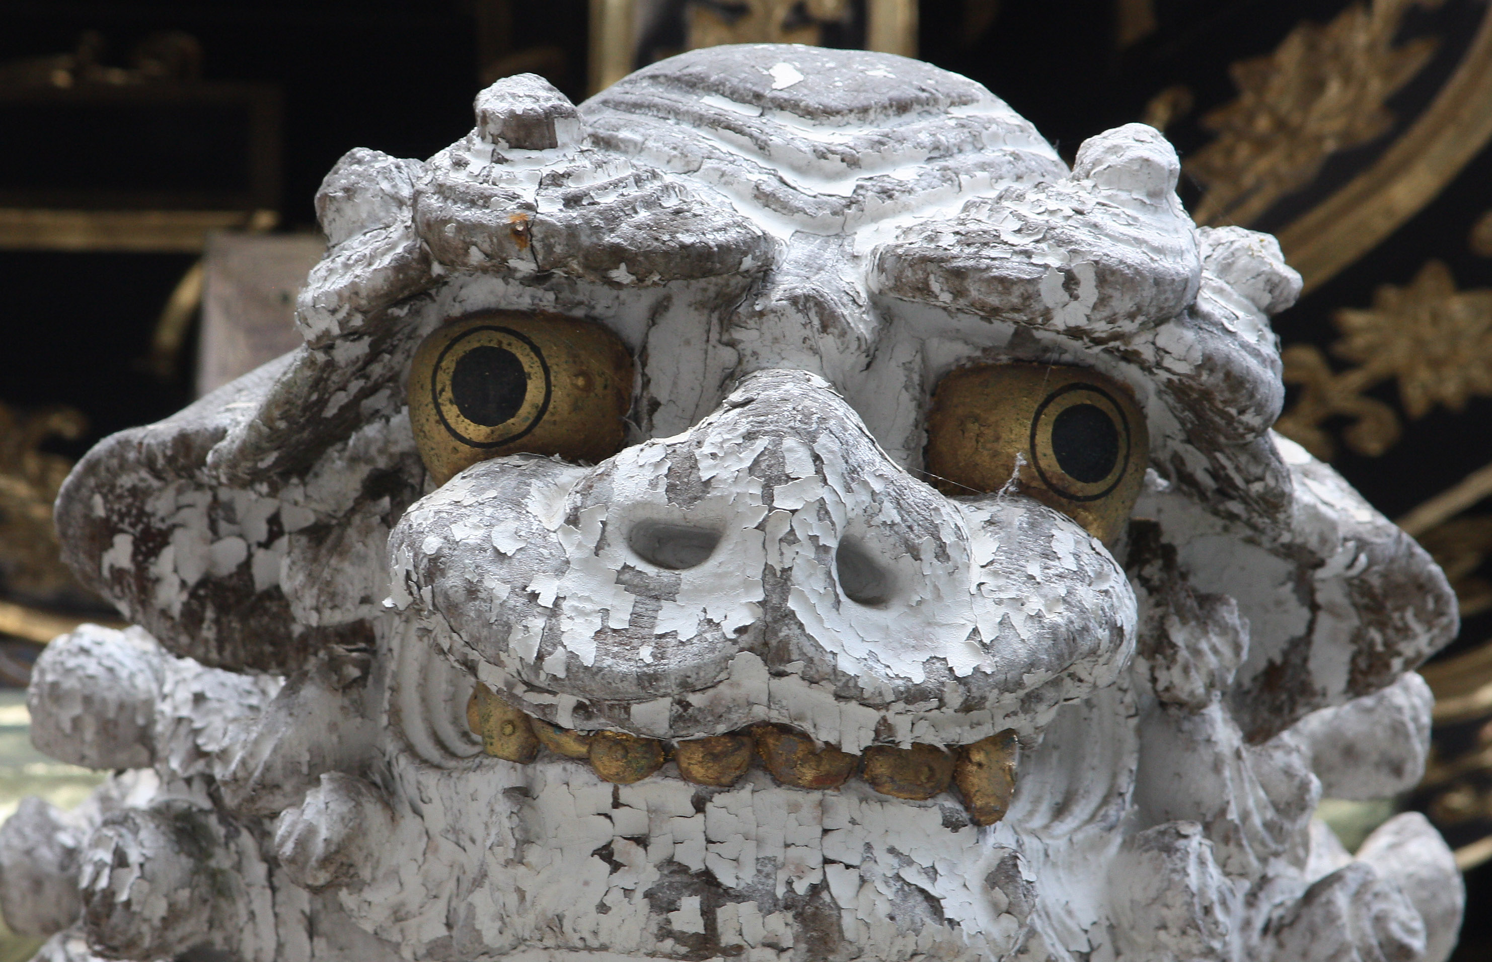
What to show?
Consider what to show, and what to leave out, of your frame.
We talked about long shots, medium shots, close-ups. But what part of each?
Often you can include less than you think—move in close.
Try to find a particular aspect that makes the picture interesting, that defines the scene.
Photo of a whole person? Or just an interesting expression?
Perhaps just a detail: peeling paint, worn cloths, rough wood. Fine a part that seems to define the whole.

Slide 17
What is the photo about?
Before shooting it’s helpful to decide what you really want to emphasize in a photo.
Why are you taking this photo? What is really important?
Look at the edges of a frame. Are you cutting off things you want to keep?
Use your viewfinder to isolate parts of a scene, to determine what you want to emphasize.
Note that a photographer starts with everything and subtracts. An artist starts with nothing and adds.
Photographers can’t control a scene the way artists can.

Slide 18
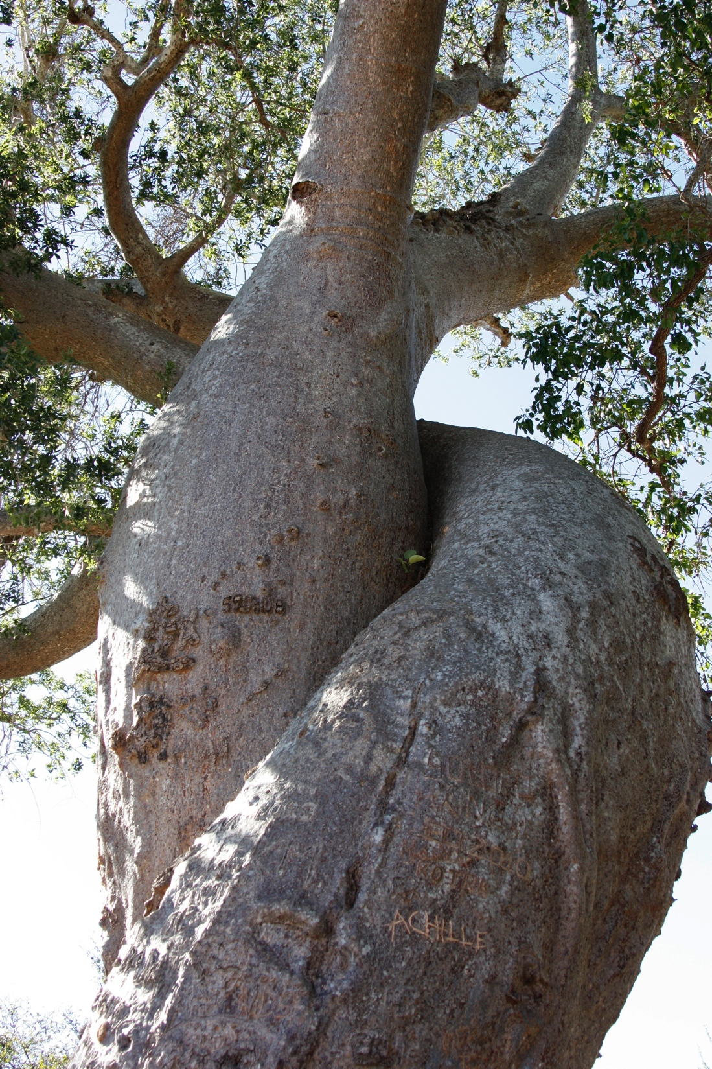
Aspect
Horizontal or vertical?
People tend to begin with mostly horizontals. But sometimes this adds nothing but empty space.
A vertical subject needs a vertical format. Turn your camera to shoot verticals!

Slide 19
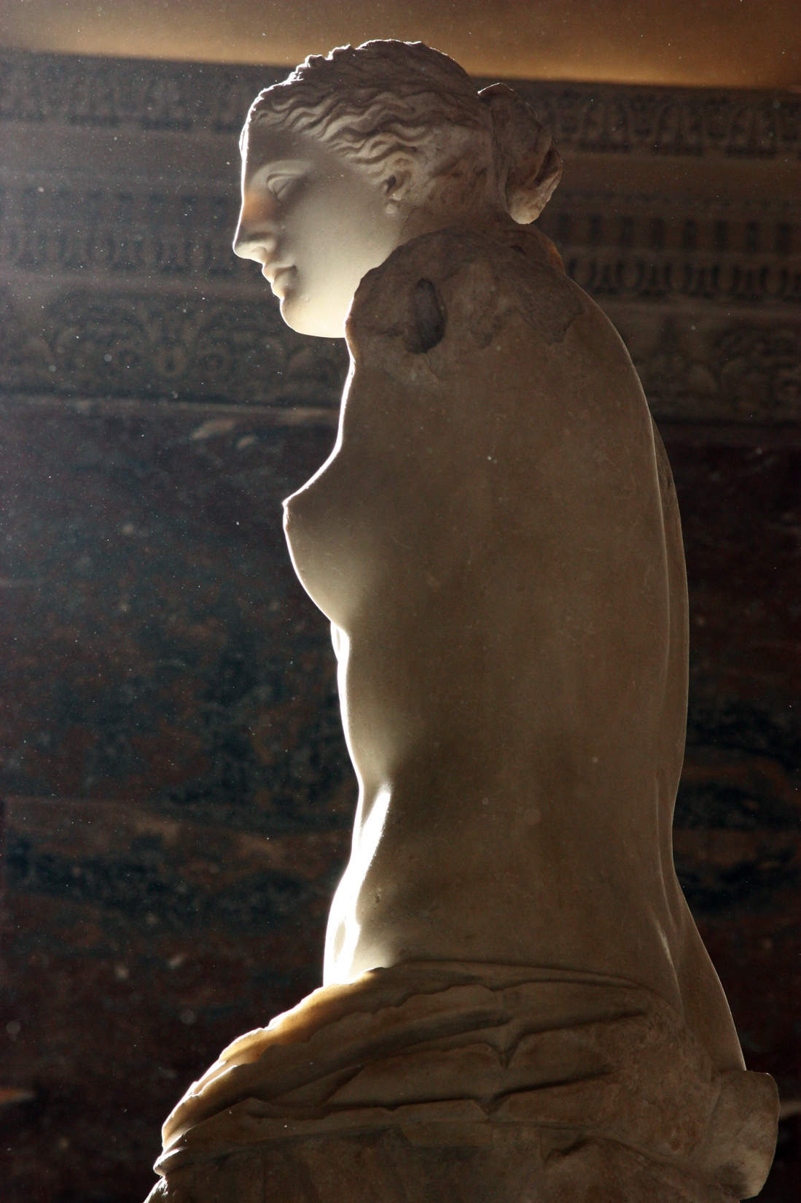
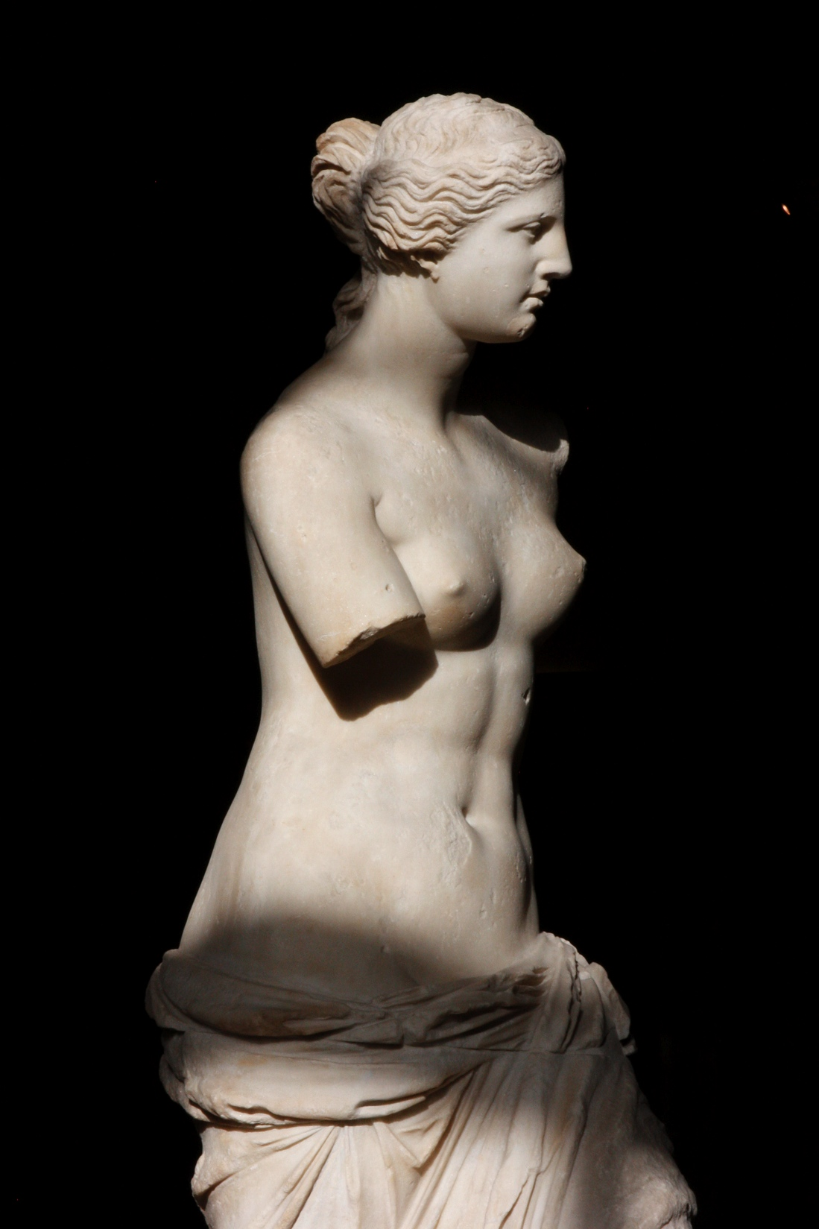
Background
It’s so easy to forget the background, not notice it, because our eyes are able to isolate the background from the center of interest.
What if the background is distracting, adds nothing?
Try to move to eliminate the distraction.
Use a shallow depth of field to make it less obtrusive.

Slide 20

Isolating
We can’t control images in mass media photography the way painters can.
We have to grab them quickly.
An interesting approach to this is knowing the eye is attracted to isolated dots, spots, or objects. These make strong centers of interest.

Slide 21
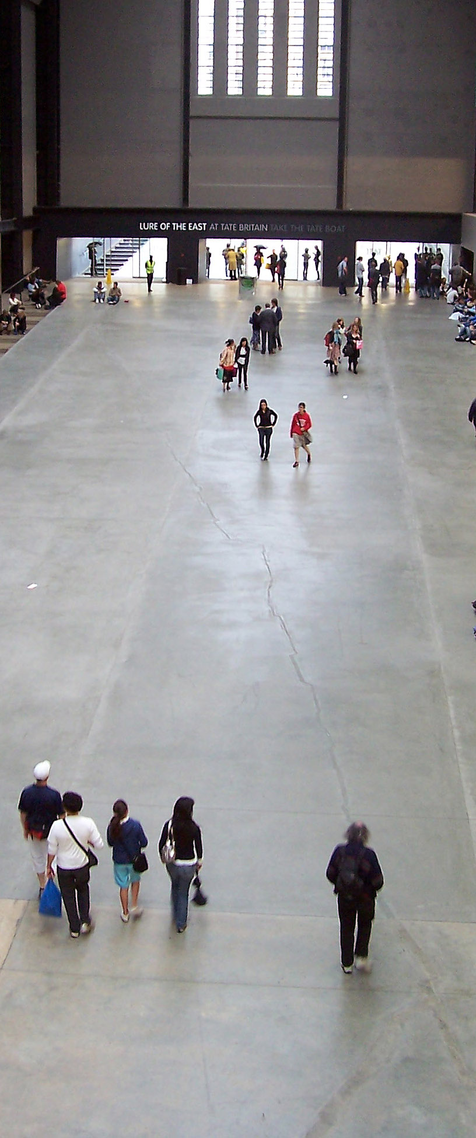
Associations
When dots or spots are close to each other, we tend to associate them psychologically—even if they may actually have nothing to do with each other.
In Gestalt psychology this is the principle of proximity.

Slide 22
Emphasis
Photographers are challenged trying to emphasize interesting parts of a photo, while de-emphasizing other parts.
In an actual scene, with so many objects demanding equal attention, how do we indicate what a viewer should look at first?

Slide 23
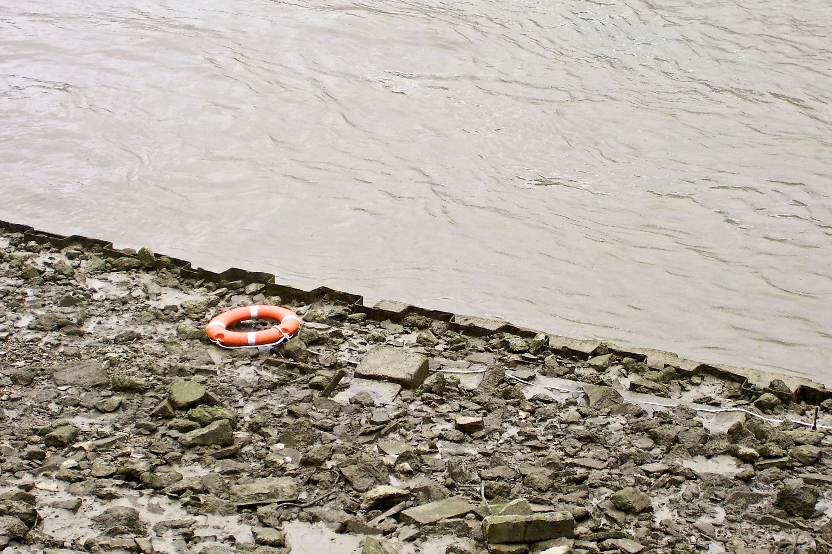
Emphasis
Contrast can help emphasize. Put the subject in a background that will make it stand out.
Contrast can be made with isolation, color, size, or what’s most in focus.

Slide 24
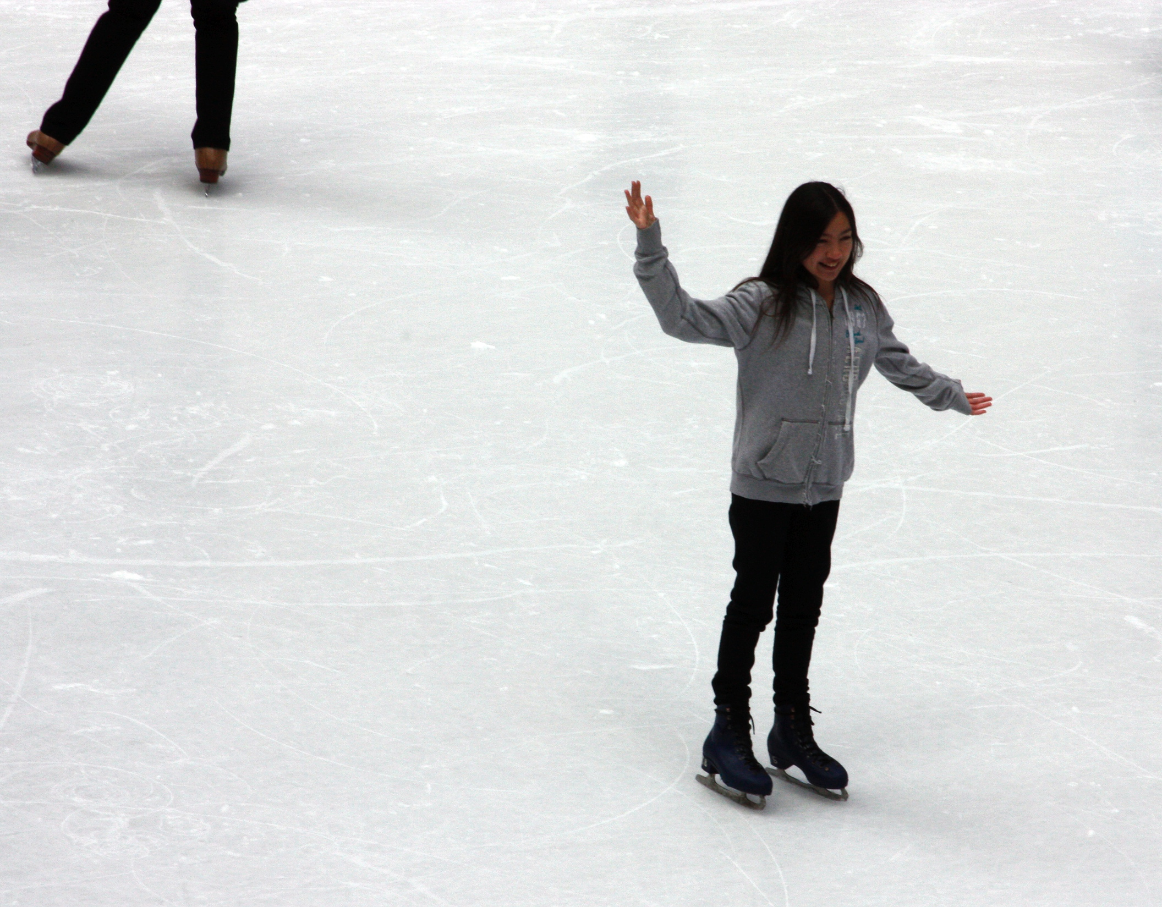
Balance
We balance a scene dynamically, not symmetrically.
Balance in a photo is a feeling. Some ideas:
Dark is visually heavier than light.
Large is heavier than small.
Object at the edge has more visual weight than object at the center.
A picture tends to feel top-heavy without more visual weight at the bottom.

Slide 25
Balance
Balance in your viewfinder is a feeling.
If the view doesn’t feel right, try moving. Even a slight change may feel more balanced.
But balance should not emphasize perfect symmetry. Tension makes the photo more interesting.
The “rule of thirds” is designed to build tension, dynamic balance into a photo.

Slide 26

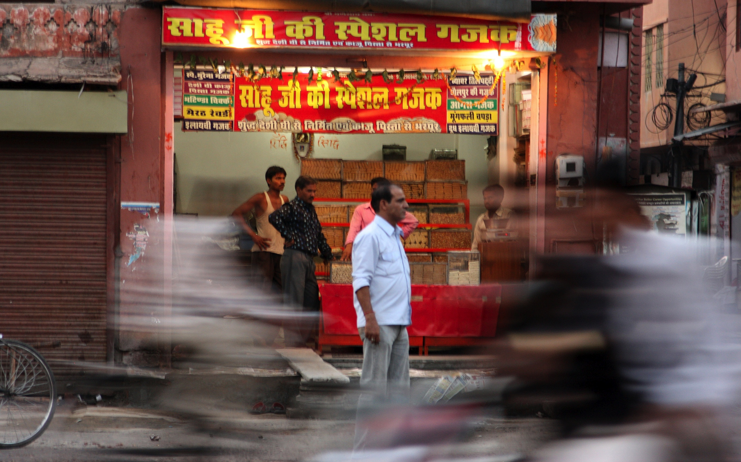
Sharpness
People tend to be attracted first to the sharpest thing in a photo.
If everything is sharp, then everything appears to have the same value.
Emphasis can be gained by making one thing sharper than the rest.
Selective blur can give a feeling of speed or action, particularly in sports pictures.

Slide 27
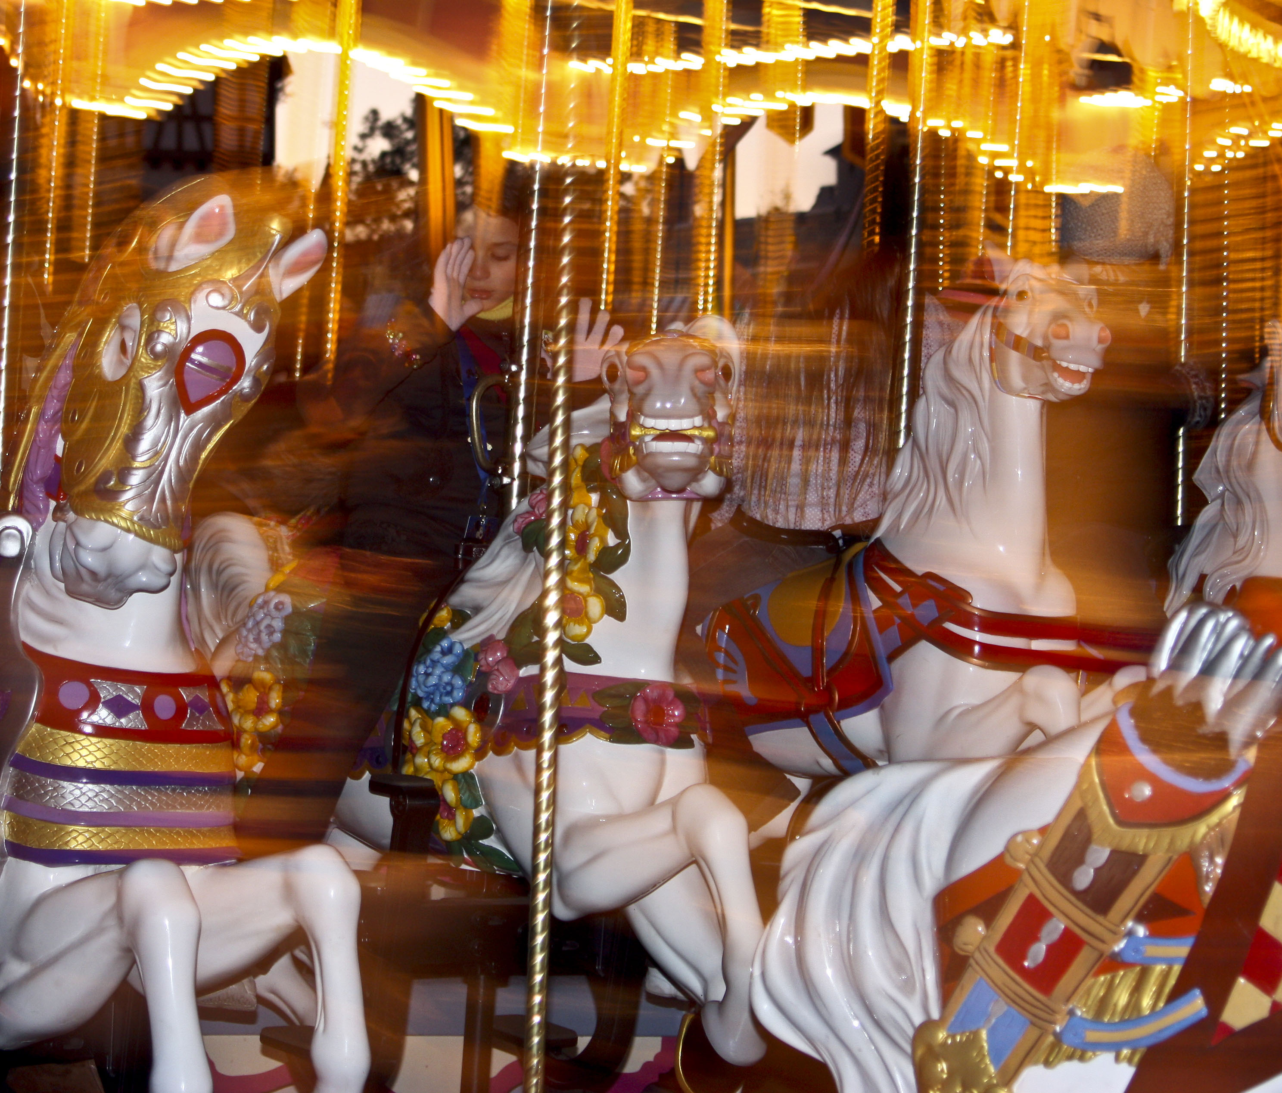
Intentional blur
You can blur parts of a scene on purpose, although something needs to be in focus. One trick is to use flash with a slow shutter speed.

Slide 28
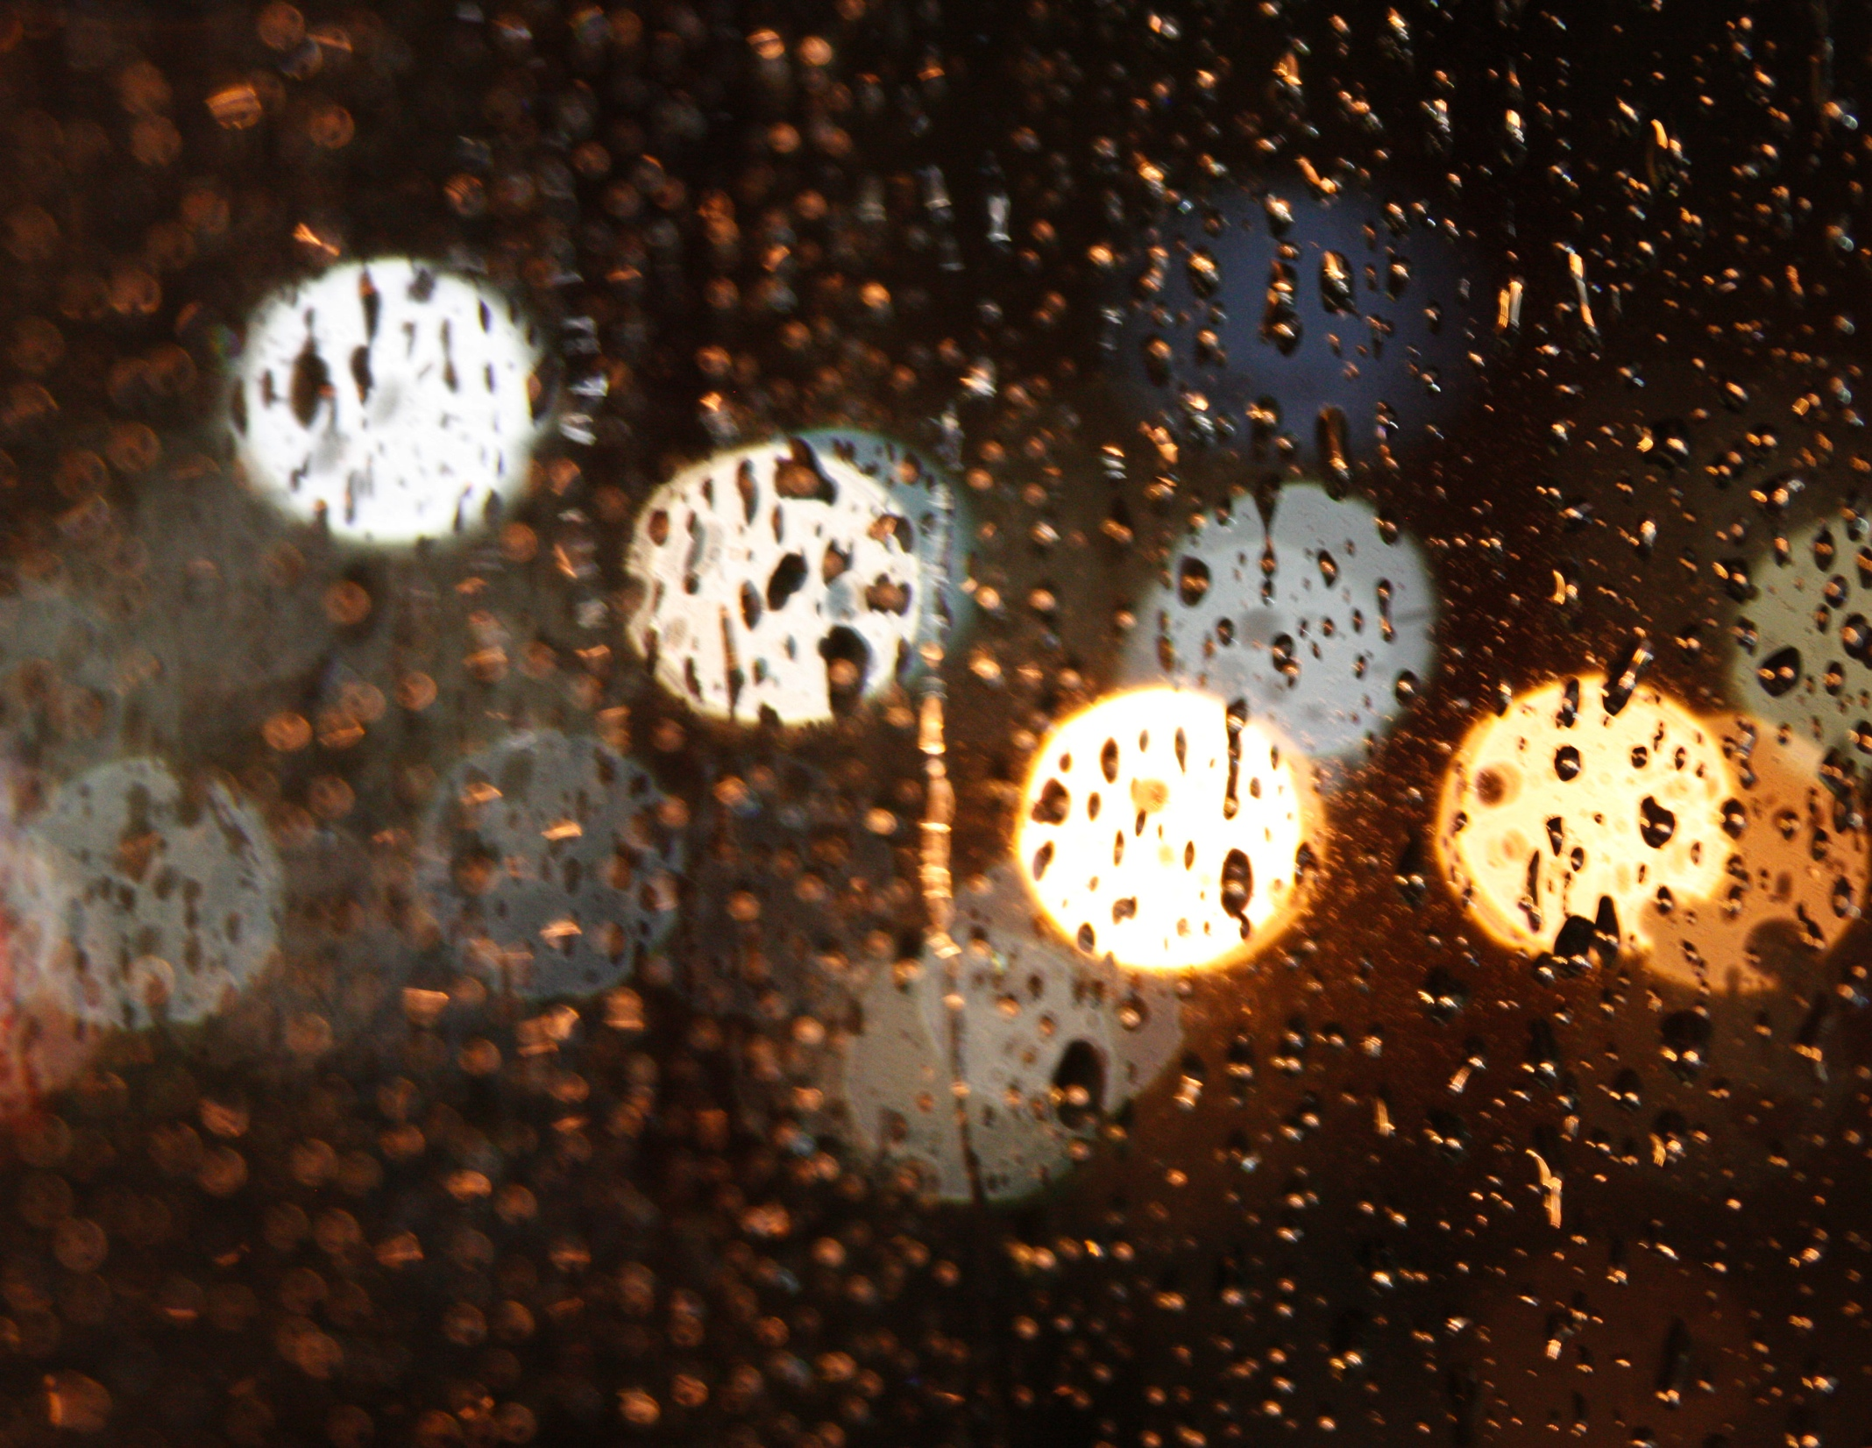
Tonal relationships
Look for interesting relationships between dark and light areas of a scene, or colors.
Try squinting into a viewfinder. This will encourage you to see less detail, and more a feeling of tonal relationships and patterns.

Slide 29
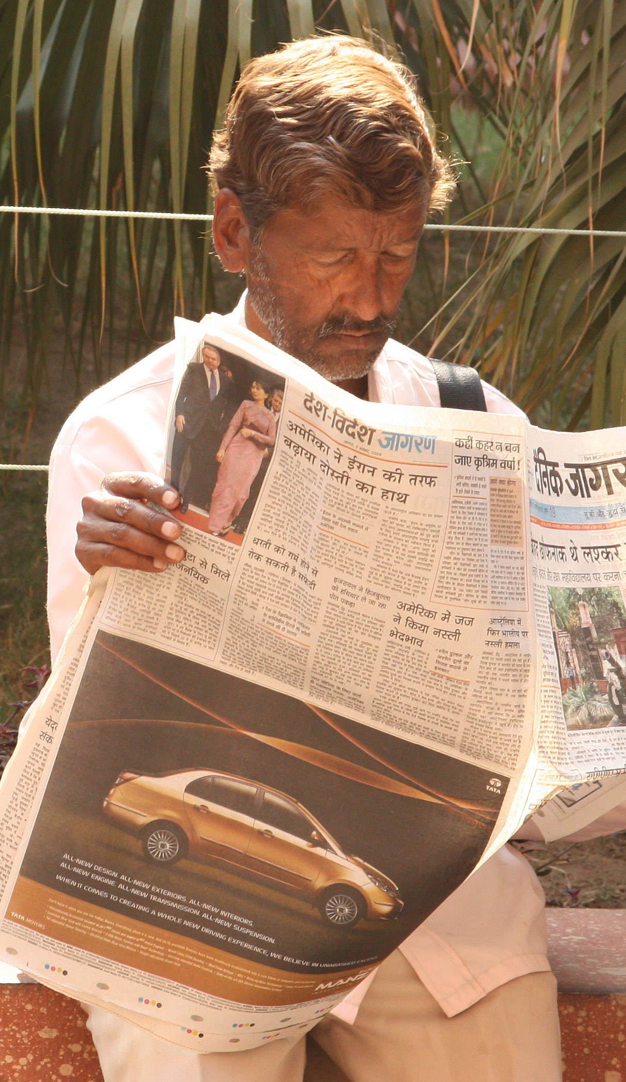
Rim lighting
Back lighting or rim lighting adds depth to a scene. Avoid flat sunlight.

Slide 30

Shadows
Look for interesting shadows.
Shadows have more visual weight, and so suggest dramatic contrasts.
This is why it’s more interesting to take pictures in the early morning or late afternoon. Shadows are longer.

Slide 31
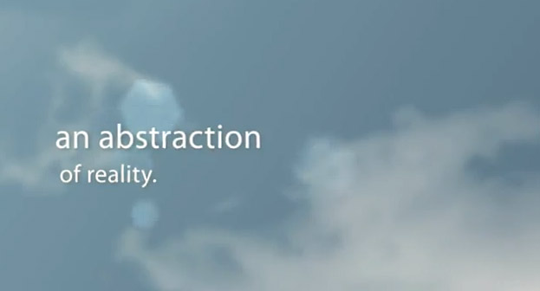
A video of ways to see
Here in video form we can study more ways to see. http://www.youtube.com/watch?v=YDMGfJ2VVs4&list=UU1MN7rBkZ0-q_ZJTOD1Ea-Q&index=14

